Slide 1

- sales
Analysis -Machine
learning project

Slide 2

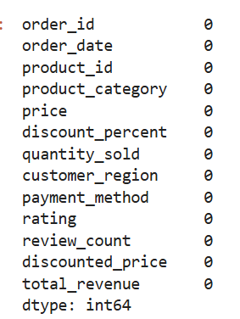
Data Cleaning (preprocessing):
Data Cleaning is the most important step for Amazon sales Project because it transforms “noisy” raw data into reliable format that machine learning model can actually easily understand.
Forst step in Data cleaning :
Importing necessary Libraries :
Pandas , numpy , Matplotlib, Seaborn , Warnings.
2. Load s Dataset using pd .read _ csv format.
3. Using d f . head code to get know top five columns.
4. Using d f . column code to get know names column headings in data set.
5. Using d f .shape code to get know how many columns and rows dataset contain.
6.Using d f. d types code to check columns entire s type ( int ,float ,boolean).
7.Handling Missing Values :
Checking missing values: d f. is null () sum () .
8.Handling Duplicate s:
d f . drop _ duplicates ( in place = True)
In this did not contain any duplicate values.

Slide 3
9. Convert Date Types :
Changing order _ date to date time object.
From Date Time object extracting 3 new columns – order _ moth, order _ year ,order Day of Week.
So from I can extract trends .
10.Data info : using d f .info () checking is new 3 columns created or not .
EDA ( Exploratory Data Analysis ) : EDA is used for finding stories in dataset.
EDA is bridge between raw data and a successful machine learning model.
1.Uncovering Hidden Seasonal Patterns .
2.Detecting Anomalies and Outliers
3.Understanding Feature Relationship s
4.Validating Preprocessing Needs.
5.Justifying Business Decision (“ The Story”)
EDA give the flashlight to see where the most important patterns are hiding.

Slide 4
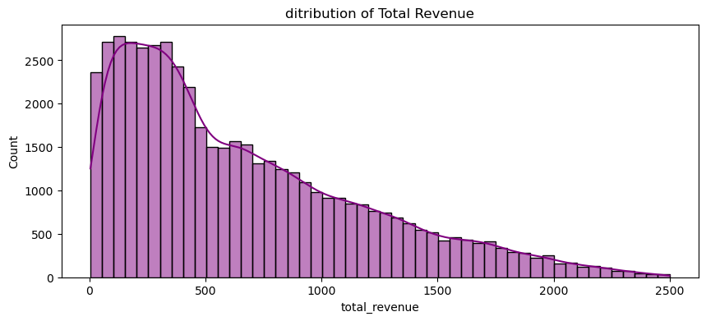
1.Distribution of Total Revenue : This Histogram with KDE has
x-axis shows total _ revenue (range 0 to 2500)
y-axis shows count of observations (frequency)
Key observation:
The distribution is “right-skewed” (positively
skewed).
Most revenue values cluster between “ 0 -500”with a peak near 200-300.
Fewer transactions generate revenue above 1000,tapering off to 2500.
Insights :
Majority of sales yield low to moderate revenue
A long tail indicates occasional high value
transactions

Slide 5
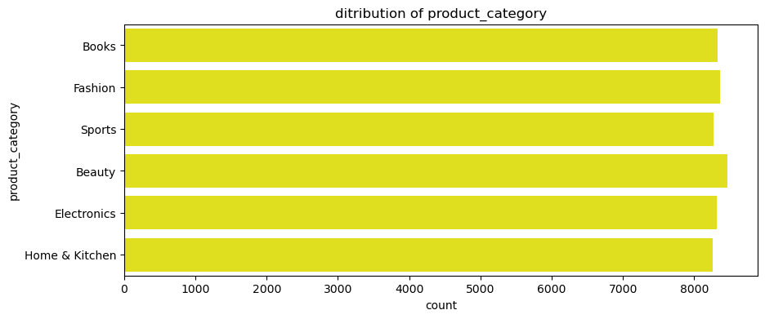
1.Product Category Distribution Analysis: This Analysis shows which product category appears most often.
Horizontal bar chart showing count of products per category (yellow bars).
Y-axis shows product category(Books ,Sports , Beauty, Electronics, Home & Kitchen).
X-axis shows Count of observations ( 0 to 8,000).
Observations:
All six categories have similar counts, ranging 8,000.
Slightly higher count for Home & Kitchen and Electronics.
Uniform distribution indicates balanced sales across categories .
Insights:
No dominant category suggests diversified product
demand.
Marketing efforts may be evenly distribution or
Need focus on under-performing sub-segments

Slide 6
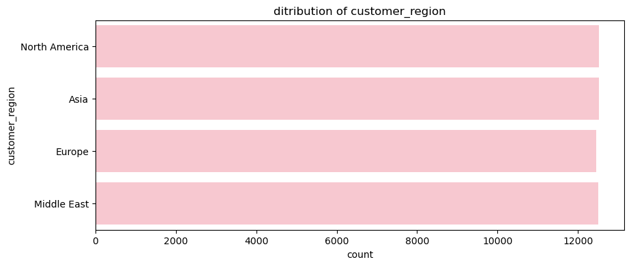
2.Distribution of Customer Region Analysis: this analysis show which Customer Region appears more often . this helps see if data is “ balanced”.
The plot shows the customer count across four regions.
Regions Displayed : North America , Asia, Europe, and Middle East.
All bars are pink and extend approximately 12,000 on the x- axis ,indicating similar customer counts in each region.
The x- axis represent the count of customers ( 0 to 12,000).
The y –axis lists the Customer Region Categories.
Insights:
Customer Distribution is roughly uniform across the four
Regions , with each region having around 12,000 customers

Slide 7
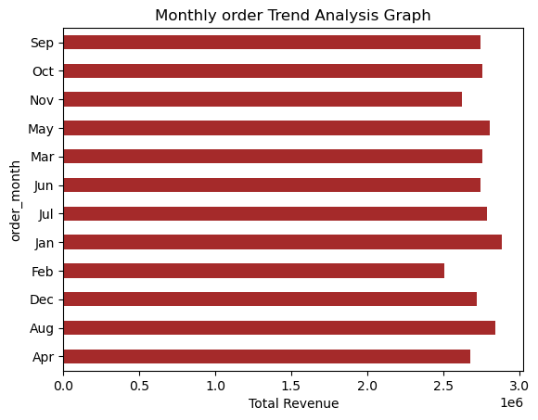
3.Monthly Order Trend Analysis : This Plot shows if the business is growing or shrinking
This horizontal bar chart represent the total revenue for each month.
Y-axis shows “ order month”
X- axis shows “ Total Revenue “
Month | Revenue
Sep | 2.8
Oct | 2.8
Nov | 2.8
May | 2.7
Mar | 2.6
Jun | 2.6
Jul | 2.5
Jan | 2.4
Feb | 2.3
Dec | 2.3
Aug | 2.2
Apr | 2.1

Slide 8
Observations:
The plot shows a Steady Increase in revenue from September to April, with the highest revenue in April.
There is a slight dip December.
Insights:
Growing Demand : The overall upward trend suggests Growing demand for products or services.
Seasonal Fluctuations : The dip in December might
indicate Seasonal Fluctuations in sales.
Opportunity for Improvement : Analysing the
December dip could help identify areas for
improvement , such as a targeted marketing
campaigns or inventory management.

Slide 9
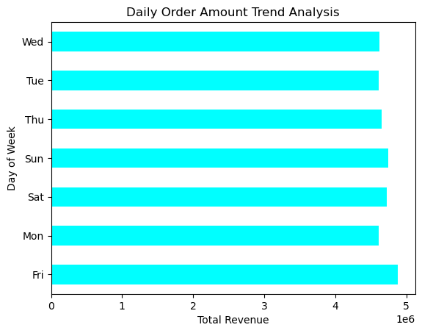
5.Daily Order Trend Analysis (Weekly Pattern) : This Analysis plot shows the Which day is best in week (Highest Orders) and this Helps decide when to offer discounts.
This plot Light blue bar graph with total revenue on the Y-axis and days of the week(Wednesday to Friday) on the X- axis.
Insights :
Increasing Trend : Revenue grows steadily from Wednesday to Friday
Highest Revenue : Friday sees the highest revenue, indicating a peak shopping day
Actionable Stepes:
Consider promotions or targeted marketing on Thursdays to
boost revenue.

Slide 10
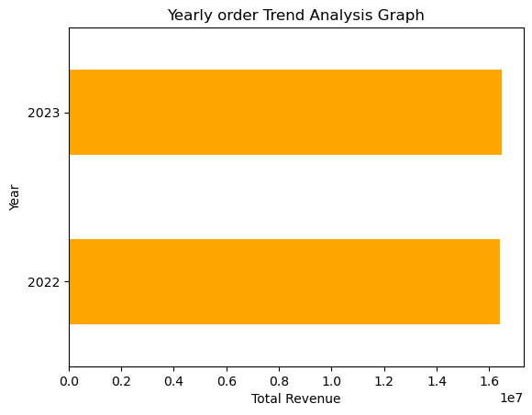
6.Yearly Order Trend Analysis :
Orange bar graph showing revenue increase from 2022 to 2023
X- axis shows Years ( 2022,2023)
Y- axis shows Revenue (0.0 to 1.6)
Insights :
Revenue Growth : steady increase in revenue from 2022 to 2023
Positive Trend : indicates growing demand for products
or services

Slide 11
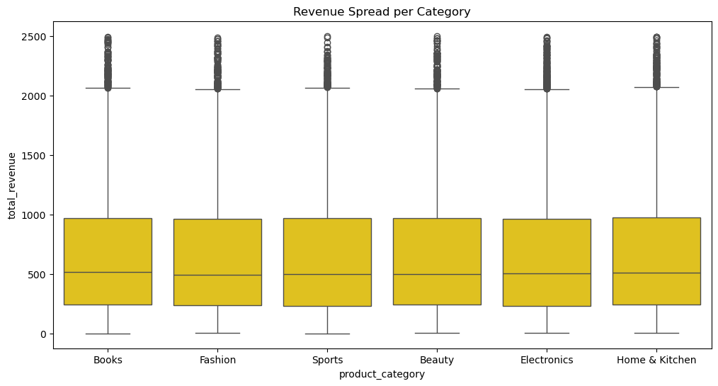
Category Vs Revenue Analysis : this Boxplot shows average revenue per category , and “spread” of outliers (items).
This boxplot title as “ revenue spread per category “ has 6 item categories ( Books, Fashion , Sports, Beauty , Electronics , and Home & kitchen .
the gold color boxes represent the interquartile range (IQR), showing where the middle 50% of revenue data lies for each category
The line inside each box indicates the median revenue.
Whiskers extend to show the overall spread, excluding outliers.
Outliers are marked with individual points
above whisker.
Insights :
Sports and Fashion shows a relatively higher
Median revenue compared to other categories.

Slide 12
Books and Electronics exhibit a broader revenue Spread (larger IQR)
All Categories have outliers indicating occasional high-revenue transactions.
Beauty and Home & Kitchen have tighter revenue distributions.
Action :
Focus marketing efforts on high – median categories like Sports & Fashion.
Monitor categories with wide Spreads ( Books , Electronics) for risk management .
Optimize inventory and promotions based on revenue consistency ( IQR size).

Slide 13
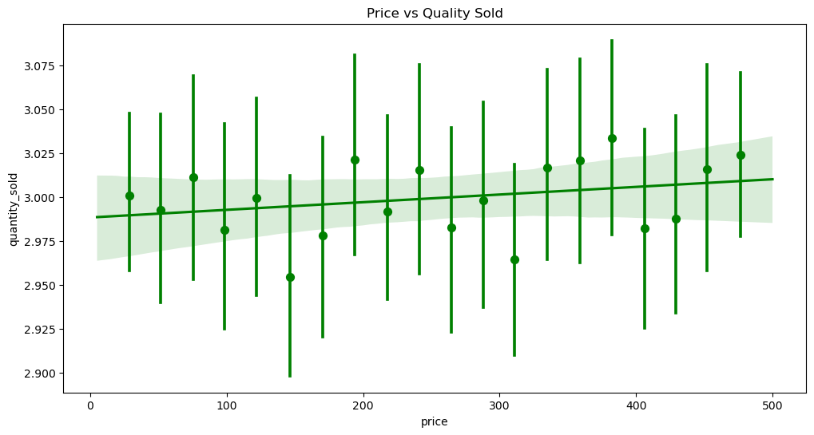
8.Price Vs Quantity Sold Analysis : this plot shows do people actually buy more when the price is lower or higher .
This Scatter with error bars (reg plot) Analysis the relationship between product price and quantity sold to understand demand elasticity
X-axis shows Price ( 0 to 500 units).
Y- axis shows Quantity Sold (2.900 to 3.075 units).
Green Line : linear regression showing a slight positive trend between price and quantity.
Vertical Green Bars : shows error margins indicating variability in quantity sold at each price point.
Insights :
the Regression line suggests a weak positive
correlation – quantity sold increases marginally
Error bars indicating high variability ,implying
other factors may influence sales more than
price alone.

Slide 14
Demand appears inelastic with in the observed price range.
The Regression Line .ignores the individual dots and shows the Vector the line slope up , it proves that as price increases , quantity sold too increases .
Pricing Strategy may need refinement ; focus on value – added features or market segmentation.

Slide 15
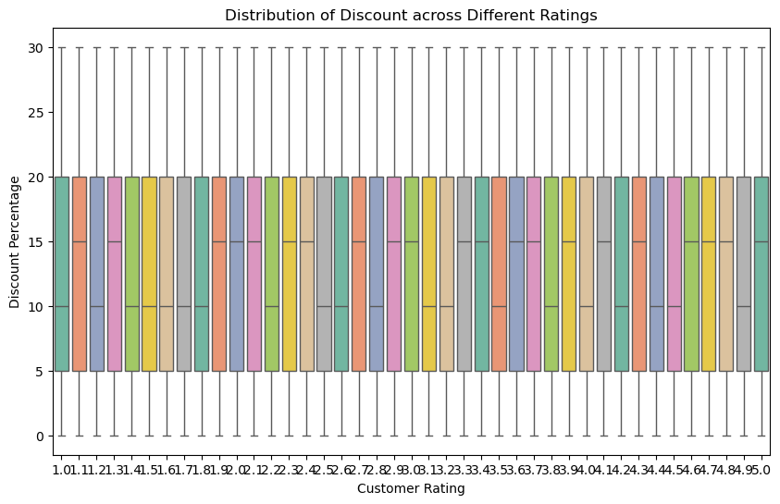
9.Discount Vs ratings Analysis: this analysis shows answer to this questions Do Higher discounts lead to better ratings or does a high discount make a product feel cheap leading to lower ratings
Distribution of Discount across different Customer Ratings.
Analysis discount percentage trends with respect to customer rating scores.
Understand how discount percentages are allocated based on customer ratings
This boxplot displays percentage on y –axis (0-30%) and Customer rating on the x –axis (1.0 to 5.0 in increments).
Each colored bar represents a specific rating inteeval , split into two segments (likely showing two discount tier or components).
Observation : Discount percentages appear relatively uniform across all ratings values, suggesting a consistence discount
policy irrespectively of rating.
Insights :
The discount structure does not heavily
favor high or low ratings ;the distribution
is balanced.

Slide 16
Marketing can focus on overall discount promotions rather than rating-specific incentives.
Monitor customer feedback to assess perceived fairness of the discount policy.
Summary : the discount distribution is even across customer ratings , indicating a non-differentiated discount strategy.

Slide 17
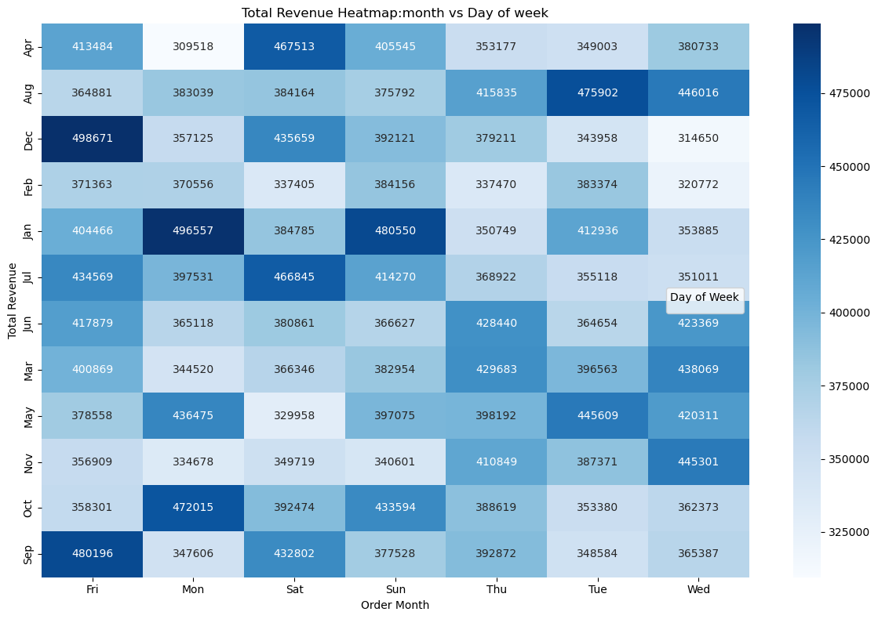
10.Monthly Seasonality : this heatmap shows which month- day combination is the “ Golden Window” for sales.
Analysis monthly revenue performance across weekdays to identify high and low-earning days.
Observations:
Darker blue cells indicate higher revenue lighter shades shows lower revenue.
Peak revenue months appear in January and December with strong Tuesday & Wednesday sales.
Sunday generally shows moderate to low revenue across most months.
Tuesday and Wednesday are the highest – earnings weekdays overall.
Insights :
Focus marketing and promotions on Tuesday &
Wednesdays to boost mid – week sales.
Investigate reasons for low Sunday performance
And consider weekend Strategies.

Slide 18
Seasonal Spikes ( ex : Dec – Jan ) suggest holiday – driven revenue patterns.
Action plans:
Allocate resources to optimize weekday operations on high-revenue days.
Run targeted campaign in low – performing months or days to balance revenue.
Monitor weekly trends to adjust inventory and staffing accordingly

Slide 19
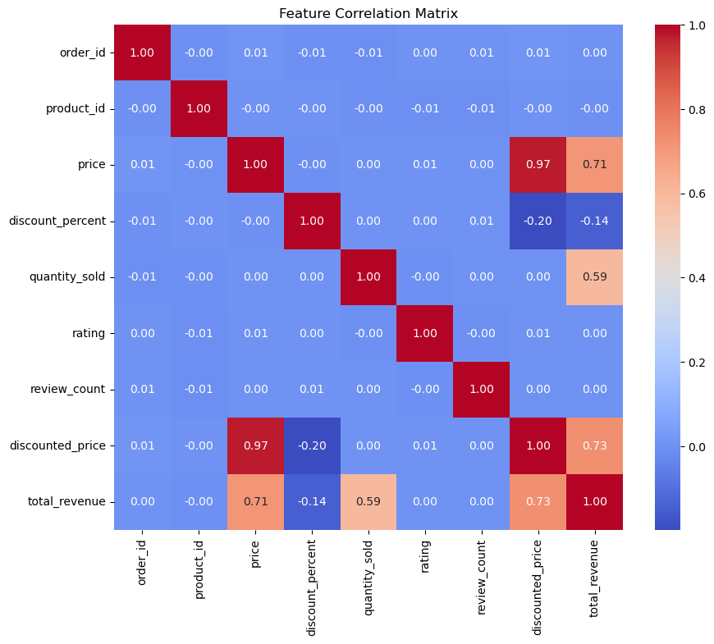
11.The Heatmap ( Correlation Matrix ) :it shows how every numerical column relates to every other column.
Purpose : understand relationship s between business features ( order _ id ,product _ id , price, discount _ percent , quantity _ sold , rating ,review _ count , discounted _ price , total _ revenue).
Correlation Matrix Explanation:
Scale -1(negative correlation) to +1 (positive correlation).
Color legend : blue means negative ,read means positive,
intensity shows strength.
Observation:
Price to discount _ price : strong positive correlation 0.97
Discount price closely follows original price.
Discount _ price to total _ revenue : high positive
correlation 0.73
Revenue driven by discount price.
Price to total _ revenue : moderate positive correlation
0.71 higher price boosts revenue

Slide 20
11.The Heatmap ( Correlation Matrix ) :
Quantity _ sold to total _ revenue : positive correlation 0.59 ,sales volume impacts revenue.
Discount _ percent to total _ revenue : weak negative correlation -20 ,higher discount slightly reduces revenue.
Rating & review – count : near – zero correlations with most variables ,minimal direct impact on revenue.
Implications :
Focus pricing & discount strategies to optimize discount _
Price for revenue.
Monitor quantity _ sold to boost revenue.
Ratings have little linear effect on sales metrics.
Summary :
Strong price - revenue linkage ; discounts need
optimization.

Slide 21
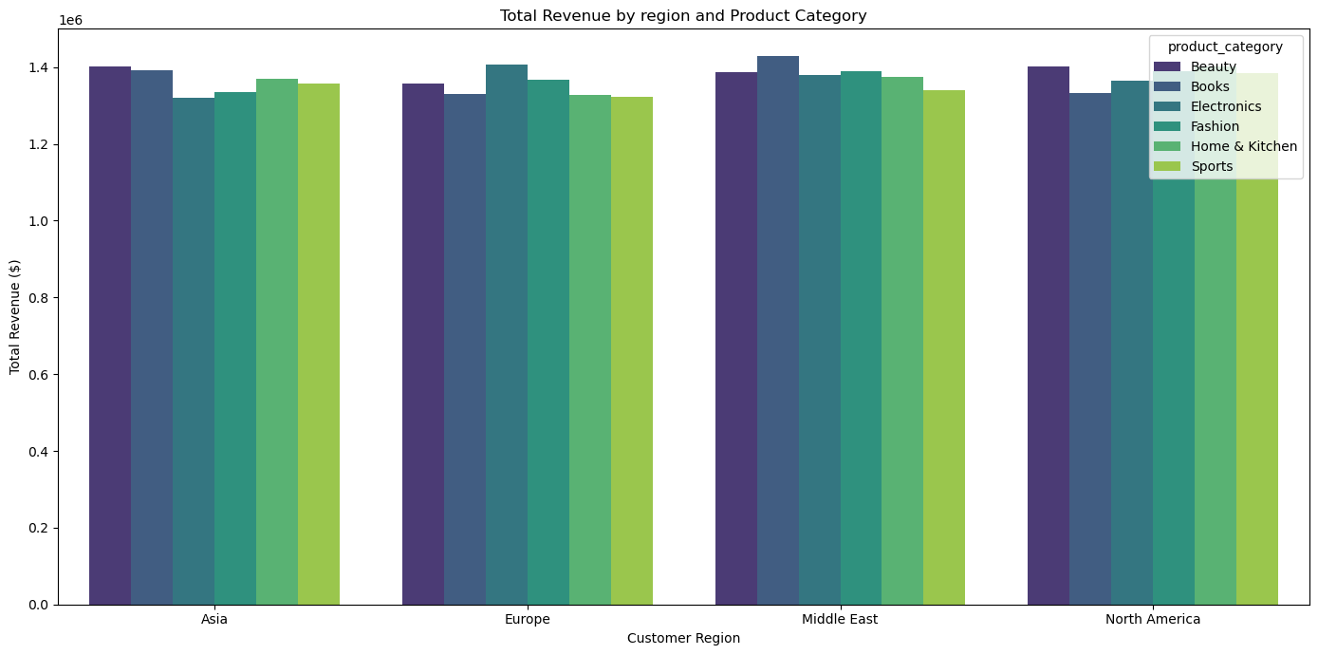
12.Total Revenue Analysis by Region and Category : (Break down of revenue in millions of Euros
This bar graph shows total revenue across regions ( Asia, Europe , Middle East , and north America) and product categories ( Beauty , Books , Electronics , Fashion , Home & kitchen , and sports).
Revenue is measured in millions of euros.
Insights :
Europe leads in total revenue , driven by Electronics and Fashion.
Asia shows strong performance in Electronics and Beauty.
North America has significant revenue from
Electronics and Home & Kitchen.
Middle East lower overall revenue , with
Fashion leading
Sports and electronics are top – performing
Categories globally.
Books have relatively lower revenue across
All regions.

Slide 22
12.Total Revenue Analysis by Region and Category :
Product category analysis:
Electronics : Top revenue contributor globally.
Fashion : strong in Europe and Middle East.
Beauty : performs well in Asia and Europe.
Sports : consistent revenue across regions.
Recommendations:
Focus on growing Electronics and Fashion in high – performing regions.
Explore opportunities in Asia for Beauty and Sports
Address lower revenue in Books through
targeted strategies.
Summary :
Regional and Category – Specific strategies can
Optimize revenue.

Slide 23
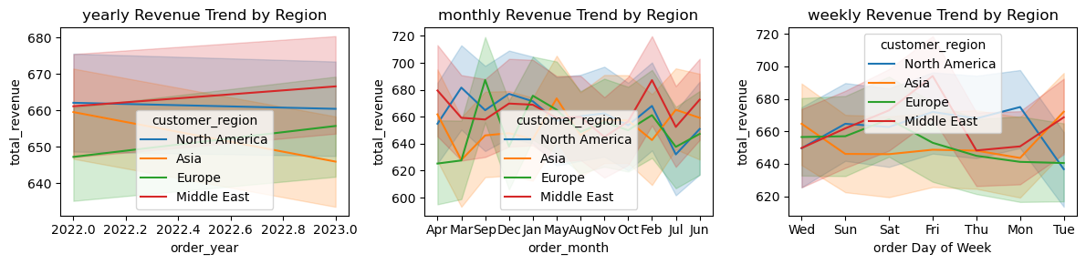
13.Revenue Trends by Region Analyzing (Yearly ,Monthly ,and Weekly Revenue Patterns) : this plots shows total revenue trends for different regions over time.
Yearly, Monthly , and Weekly trends are shown, highlighting variations in revenue.
Insights:
Customer region shows a steady increase in revenue overtime.
Other regions exhibit fluctuations, with some experiencing declines or plateaus.
Seasonal patterns may be influencing monthly and weekly trends.
Regional Performance:
Focus on Customer Regions growth, exploring drivers behind the steady increase.
Investigate declines or slowdowns in other regions for targeted strategies.
Recommendations:
Leverage growth in Customer Region with
targeted marketing.
Develop strategies to boost revenue in
underperforming regions

Slide 24
1.Linear Regression (The Baseline):
I Run this model first as a “sanity check”.
Why I am Using it : It is very fast and easy to explain
It gives you simple coefficient for every feature ( for example : “for every $1 increase in Price , revenue increases by $X”).
Model building:
Importing necessary scikit libraries .
Data Preparation : preparing features (x) , target(y)(total _ revenue).
Drop the order _ date , unique id (order _ id) which don’t help in prediction.
Apply Label Encoder to Categorical columns(data) (model needs numbers , not word) applying on categorical columns (product _ category, customer _ region , payment _ method, order _ month , order Day of Week).
Data split : split data into(80%) training and testing(20%) set .
Checking training and testing sets , of features and target sets.(by using shape function).

Slide 25
1.Linear Regression model :
I Run this model first as a “sanity check”.
Why I am Using it : It is very fast and easy to explain
It gives you simple coefficient for every feature ( for example : “for every $1 increase in Price , revenue increases by $X”).
Importing Libraries:
Linear Regression : Model for fitting a linear relationship
Standard Scaler: standardize features by removing mean & scaling to unit variance.
Data Preprocessing – Scaling:
Fit Scaler on training data & apply it to both train & test sets.
Avoids data leakage by using transform for test data.
Model Training:
Instantiate a linear regression object.
Train the model on scaled training features and labels.

Slide 26
Model Predication: use the trained model to predict on scaled test features.
Model Evaluation :
Metrics :
R2 Score : indicates model fit ( closer to 1 is better).
MAE : mean absolute error – average magnitude of errors.
MSE : mean squared error – average of squared errors.
RMSE : root mean squared error - square root of MSE.
Results :
R2 Score : 0.8778 ( good fit).
MAE : 133.63
MSE : 33121.95
RMSE : 181.99
Interpretation : model explains – 87.8% variance ; error metrics indicate prediction accuracy.

Slide 27
2.XG Boosting Model Importance:
XG boosting model is great choice for this dataset because of several reasons that align with its strengths:
1.Handling Large Data Set : this data modern sized having 50,000 entries and 16 columns, so X g boosting handles this dataset efficiently due to its optimized computational performance.
2.Mixed Data types :The data set contains a mix of numeric ( int ,float ) and categorical/object columns(example product _ category , customer _ region , payment _ method).
XG Boost can work with numeric features directly and can handle encoded categorical features well, making it versatile for this type of data.
3.Robust to missing values : XG Boost has built – in handling for missing data
4.High Predictive Performance : XG Boost is known for its strong performance in structured data tasks like regression or classification due to its gradient boosting framework and regularization options
5.Feature Importance : XG Boost provides insights into feature importance, helping you understand which columns ( example Price , discount _ percent , order Day of Week) drive predications.
6.Speed & Scalability : its parallelized implementation makes training fast, which is beneficial for iterative model tuning on a dataset of this size.

Slide 28
2.XG Boost Regression model Implementation:
Importing XG Boost from scikit Libraries.
Model setup
XG B Regressor : Gradient boosting regression model form XG Boost library.
Parameters:
n _ estimators = 100 : Number of boosting round / trees.
Learning _ rate = 0.1 : step size shrinkage to prevent overfitting.
Max _ depth = 5 : Maximum tree depth for each tree.
Model Training :
Fitting the model :
Fit () : Trains the XG Boost model on training data x _ train ( features) and y _ train ( target).
Objective : Minimize predication error on the training set.
Prediction & Evaluation :
Making Predication & Evaluating Performance
Predict () : Generates predictions on test data x _ test.

Slide 29
Metrics :
R2 Score : Measures how well the model explains variance in the data (0 – 1, closer to 1 better).
MAE( mean absolute Error) : Average absolute difference between actual and predicted values.
MSE( mean squared error ) : Average of squared differences ( penalizes large errors).
RMSE ( root mean squared error) : Square root of MSE ; interprets error in the same units as the target.
Results :
R2 Score : 0.9999391994581474 -> model explains 99.99% of variance ( very good fit).
MAE : 3.05493596141815 -> Average error of – 3.05 units.
MSE : 16.485545383516676 -> Squared error magnitude.
RMSE : 4.0602395721824935 -> typical prediction error of -4.06 units.
Summary : The high R2 and low error values indicate a strong predictive model.

Slide 30
3.Random Forest Regression Model Importance :
the random forest regression model is good fit for this data set because of several Characteristics that make it suitable for complex , mixed – type data.
1.Handling Mixed Data types : numeric ( int , float ) and categorical ( object ) columns. Random forest can process both numerical and categorical features with out needing extensive
Preprocessing like one – hot encoding.
2.Non – Linear relationship : The model captures non – linear interactions between features ( example : price , discount _ percent , quantity _ sold) and the target ( total _ revenue), which is useful when the relationship is not simple linear regression
3.Robustness to overfitting : with 50,000 records and many features , random forest reduce overfitting by averaging multiple decision trees, giving more stable predictions.
4.Feature Importance : It provides insight into which variables ( example : price , customer _ region) drive the target ( total _ revenue), helping us understand business drives.
5. Handling large data sets: The model scales reasonably well with 50,000 entries and cab manage the memory usage ( 5.5 + MB) efficiently.

Slide 31
3.Random Forest Regression Model Building :
Import random forest Regressor (ensemble method) from scikit library.
Model Implementation:
Model initialization :
Training:
N _ estimators = 100 : 100 decision tress in the forest
random _ state = 42 : ensures reproducibility.
Prediction & Evaluation :
Prediction on test data:
Evaluation metrics :
R2Score : measures model fit (0.999998271862167).
MAE ( Mean Absolute Error) : 0.13001842999999788.
MSE(Mean Squared Error) : 0.046856974946997636.
RMSE(Root MSE): 0.21646471986676635.
Interpretation:
High R2 (=1) indicates excellent fit on test data
Low MAE/MSE/RMSE suggest accurate predictions.

Slide 32
Thankyou

